Slide 1

What’s New In
Corey Snipes, Twomile Heavy Industries Inc.
2021 STRATUS Conference

Slide 2

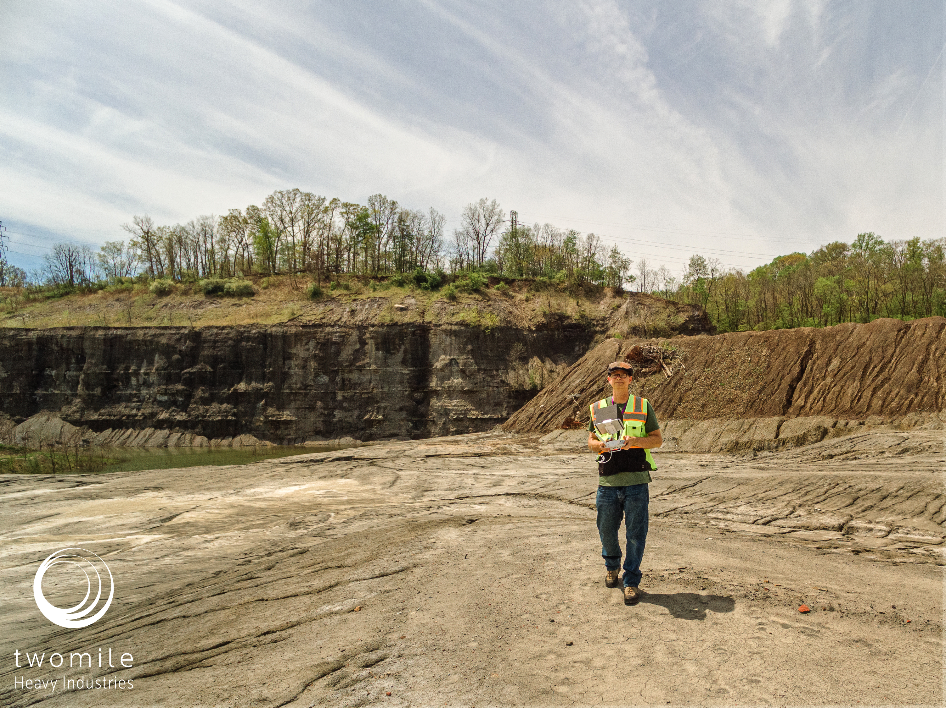

About Me
ODM Contributor
Aerospace Software Engineer
Focus: Air Traffic Management, Cybersecurity
Part 107 Commercial UAS Pilot
Focus: Mapping and Modeling in Urban and Coastal Contexts
Board President, North Coast Drone Alliance
Based in Cleveland, Ohio
Photo Credit: Susan Snipes

Slide 3
Agenda
What is ODM
ODM Outputs
What’s New in ODM
Future Capabilities
Q&A

Slide 4
What is ODM

Slide 5
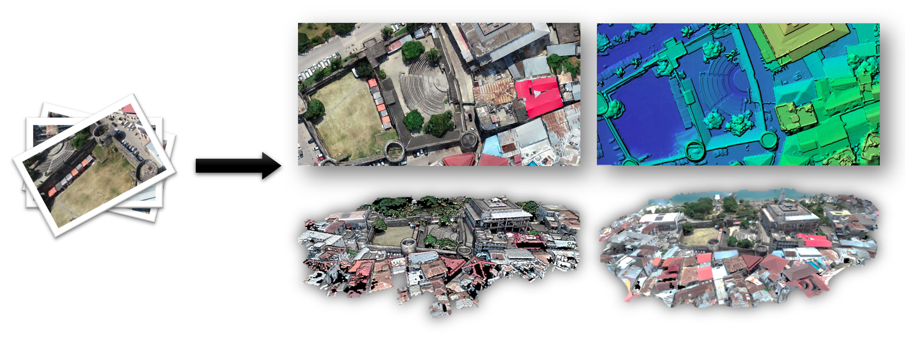
Overview
Open-source toolkit for photogrammetry from UAS imagery and sensor data
Used globally by universities and research programs
Used by the Red Cross, World Bank, United Nations
Begun in 2014, significant improvements 2018-2021
Output Quality
Features
Usability

Slide 6
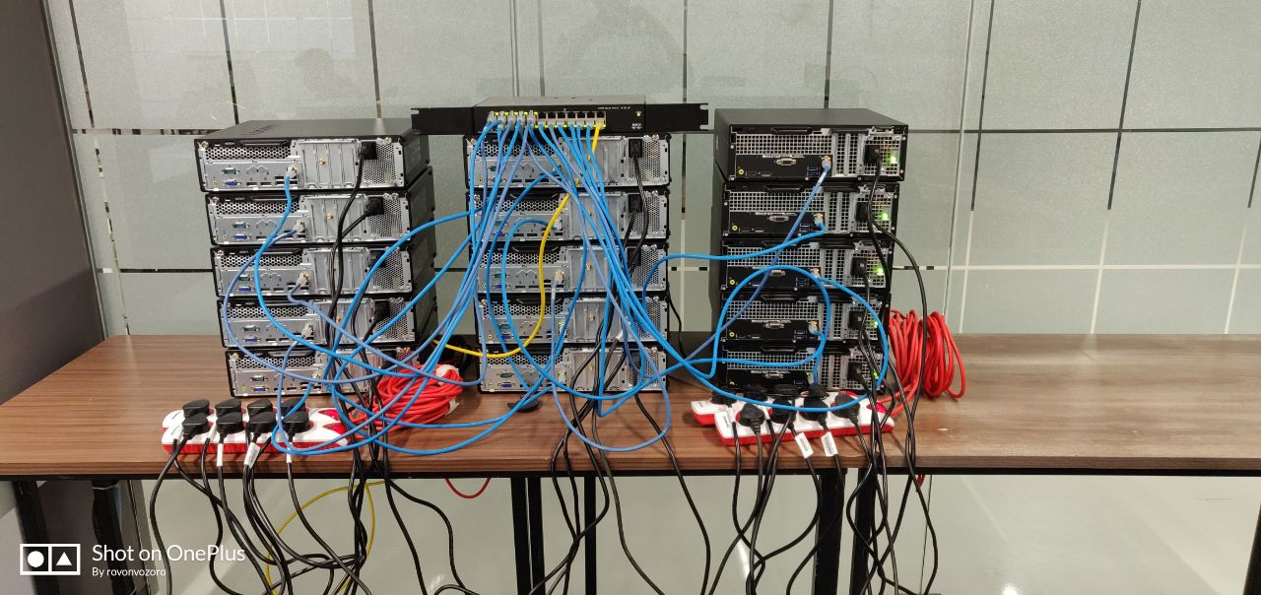
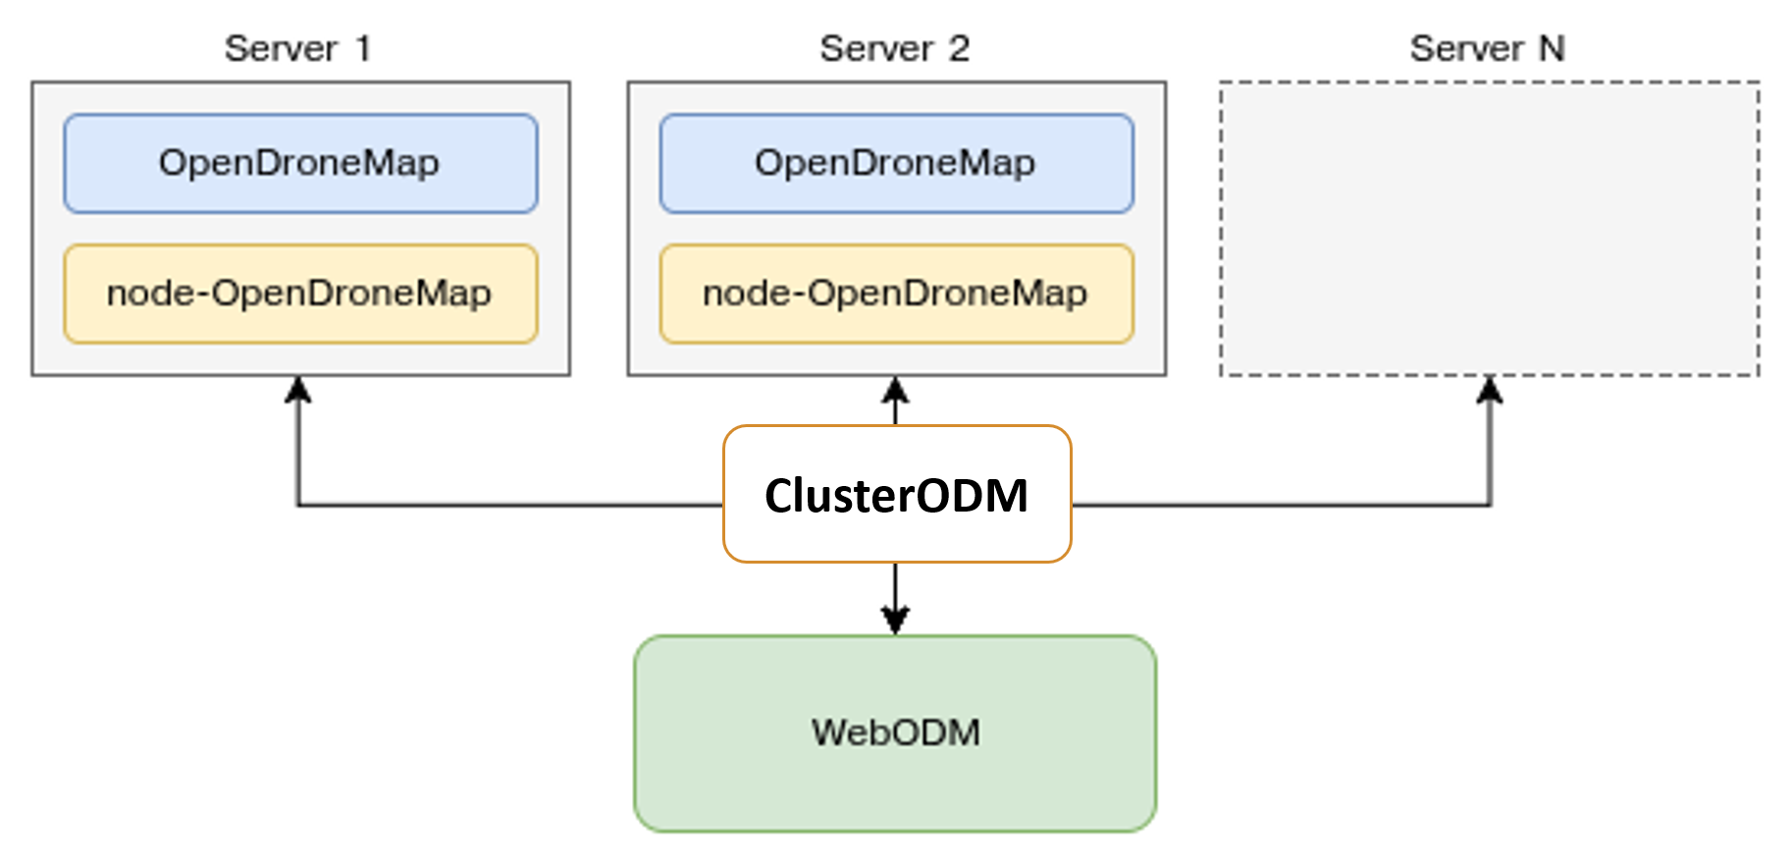
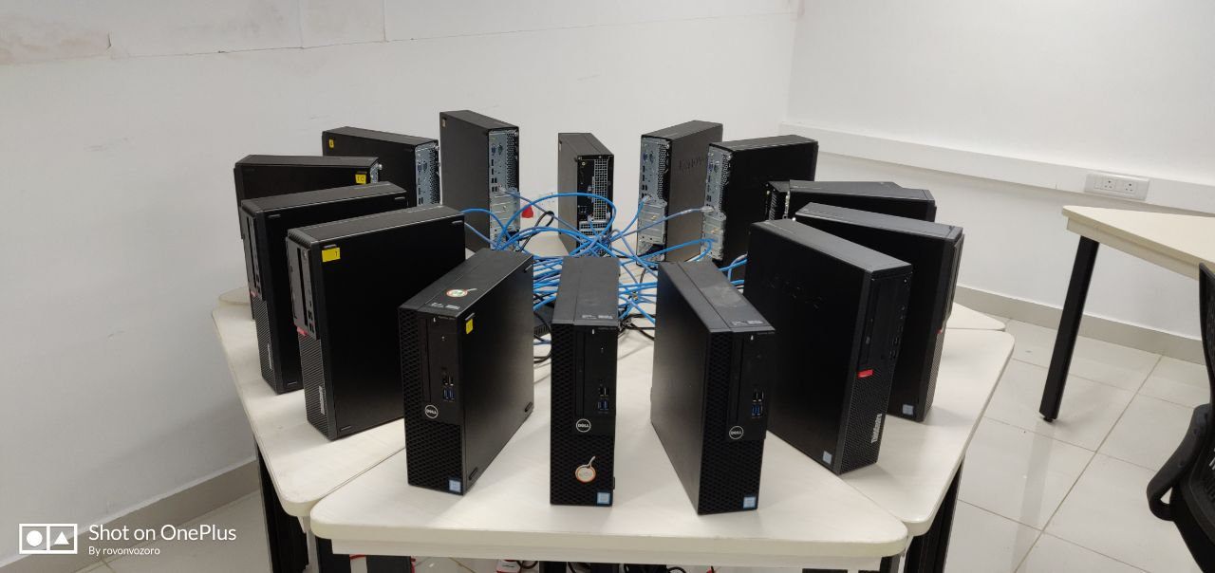
Architecture
70,000 – 90,000 images
Photo Credit: opendronemap.org

Slide 7
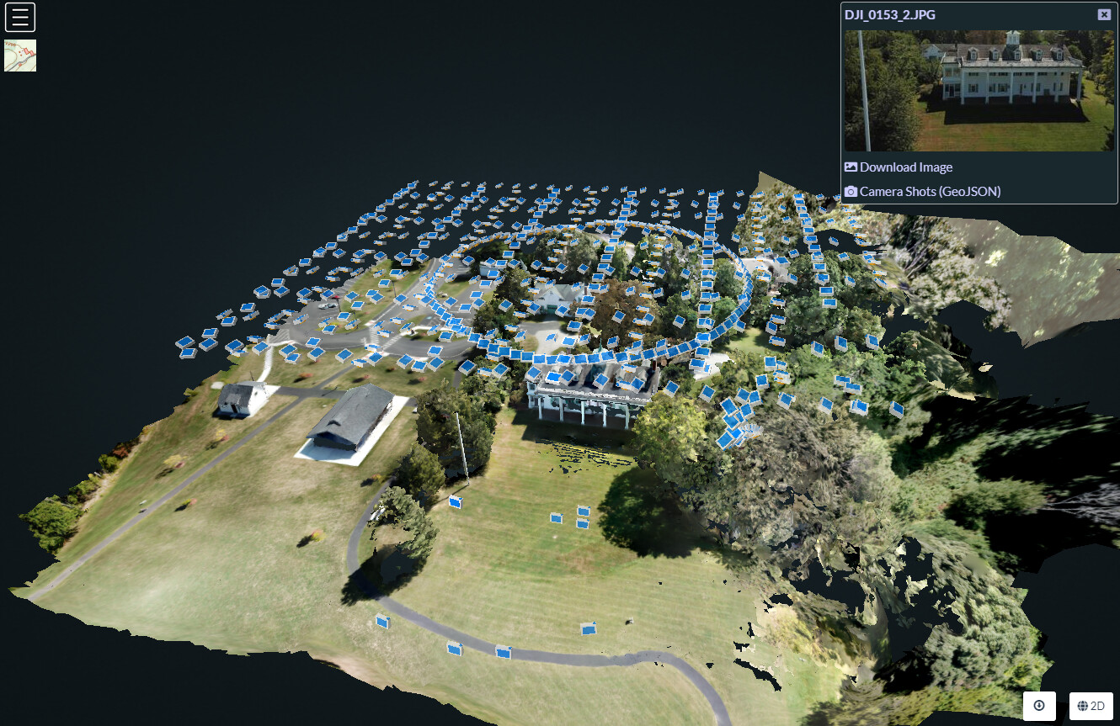
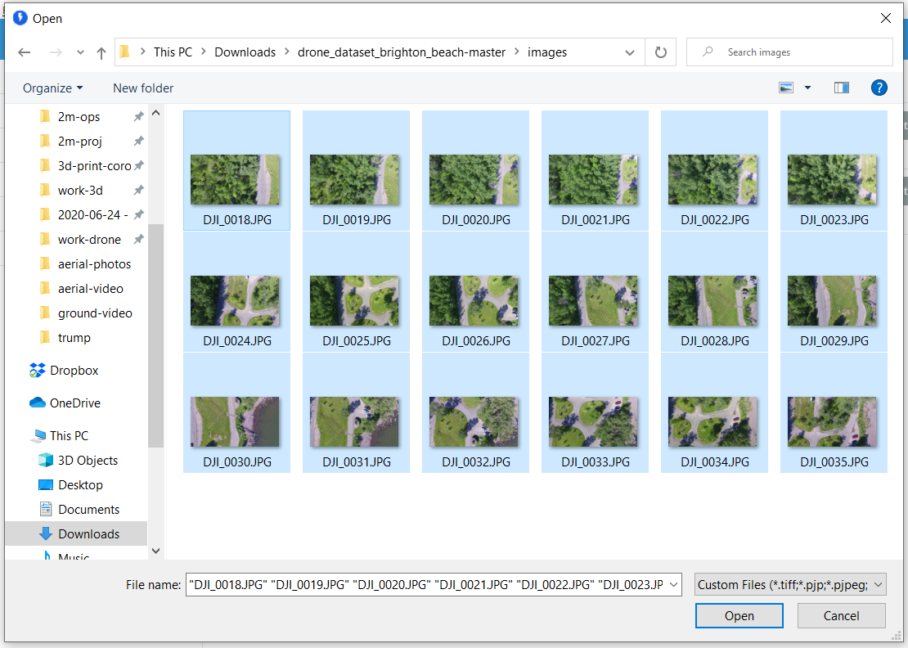
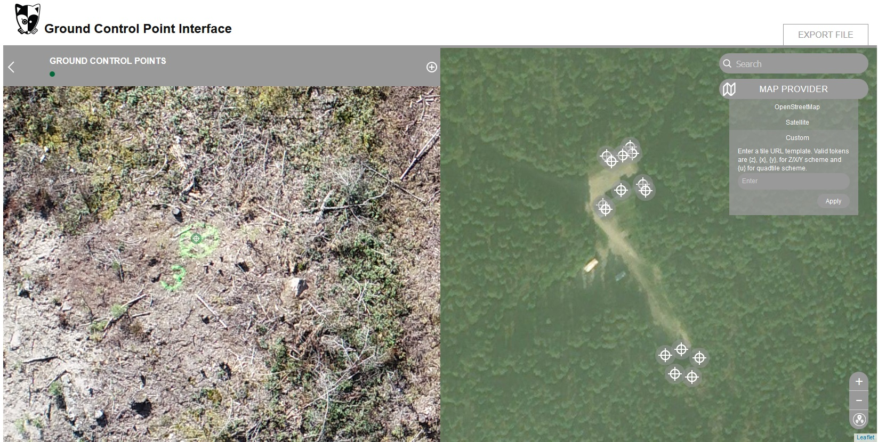
Inputs
Photo Credit: Jamie Portolese

Slide 8
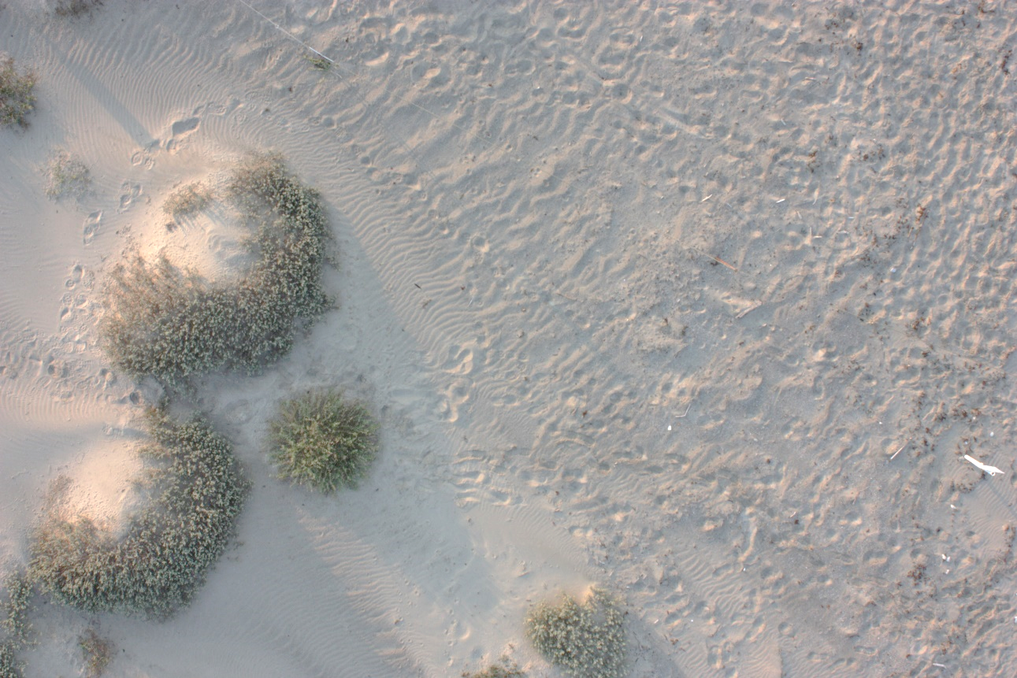
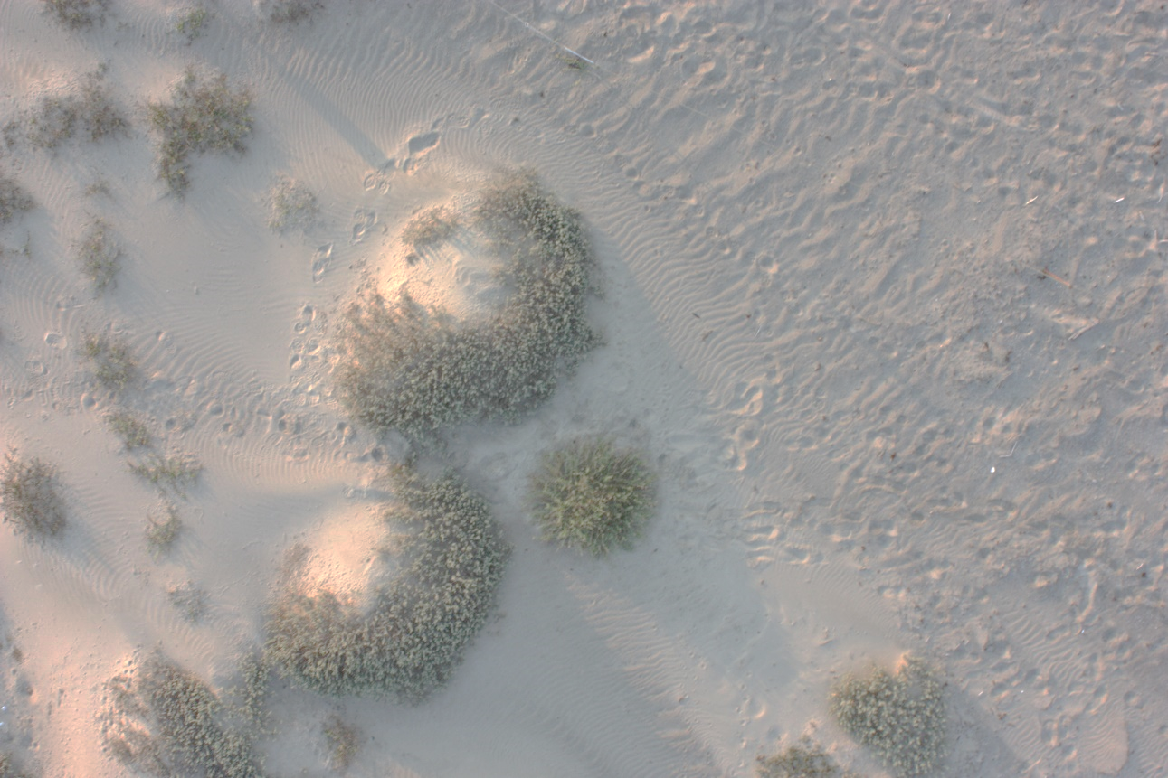
Structure-from-Motion Photogrammetry
2D → 3D
Photo Credit: Michelle Tobias

Slide 9
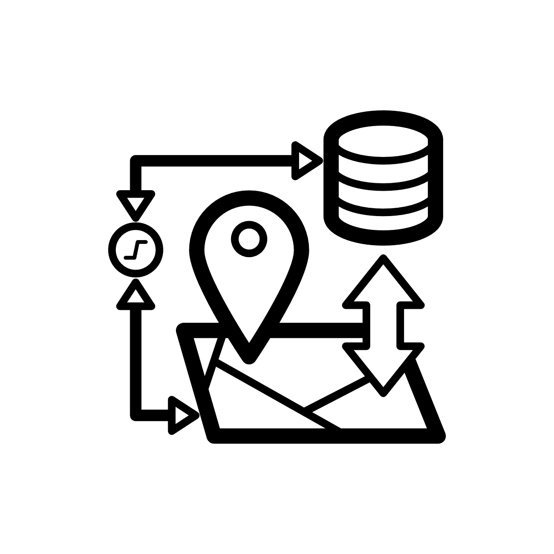
Process
Extract image metadata (location, camera, etc.)
Structure-from-Motion → Sparse Point Cloud
→ Dense Point Cloud
→ Textured Mesh
→ Georeference from images and/or ground control
→ DSM/DTM
→ Georeferenced Orthophoto

Slide 10
ODM Outputs

Slide 11
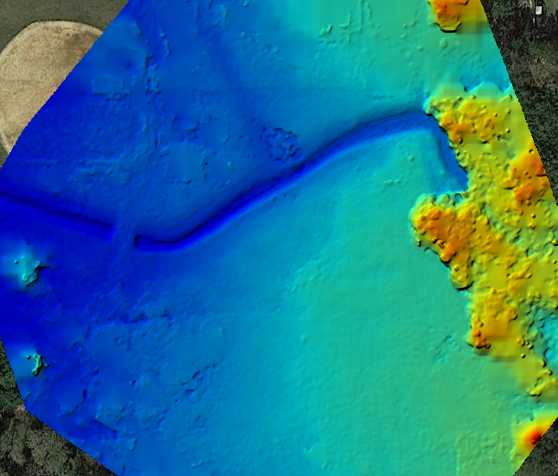
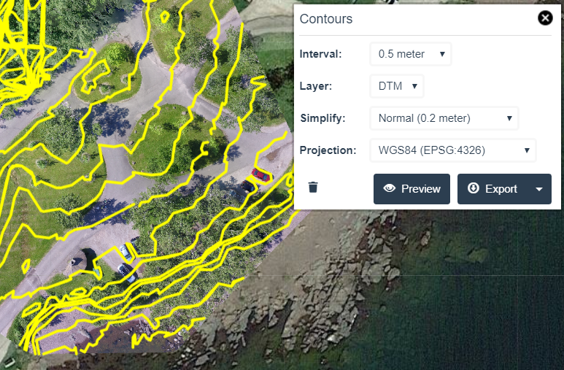
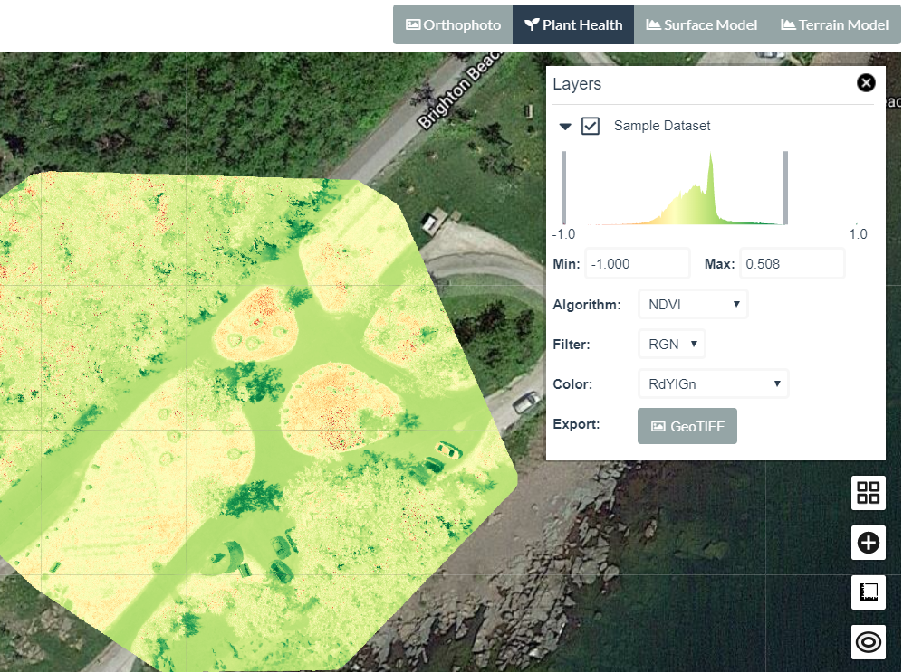
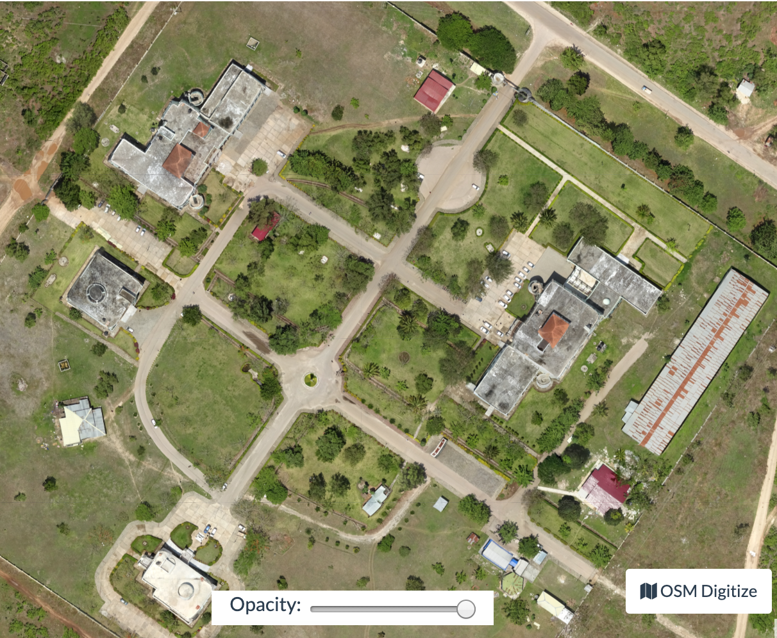
Outputs
DSM / DTM / Contours
Plant Health
Orthophoto (GeoTIFF)
→ QGIS/ArcGIS
→ Object detection/counting via FieldMapR, rastervision.io
Photo Credit: opendronemap.org

Slide 12
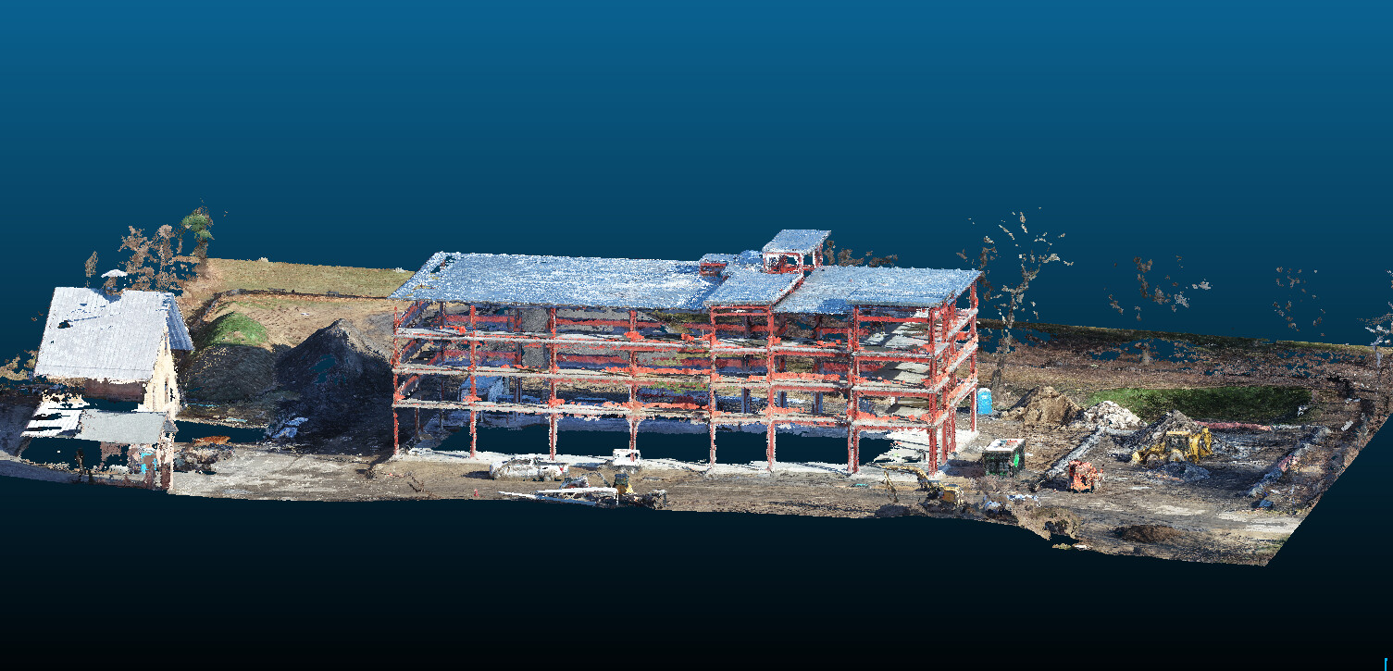
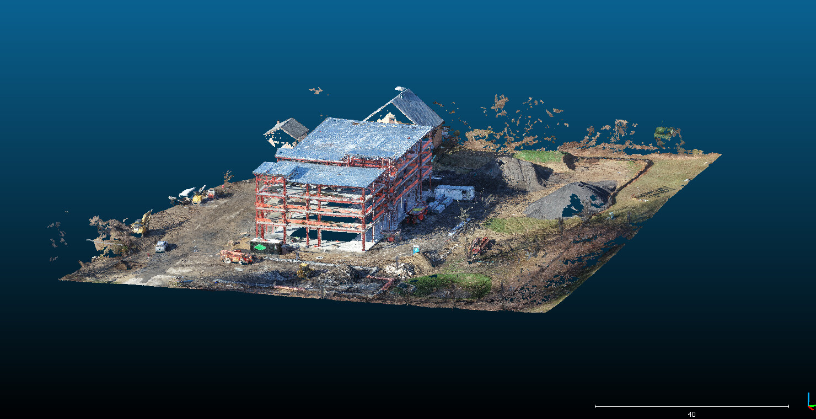
Outputs
Dense Point Cloud (.las/.laz)
→ CloudCompare, etc for analysis
Photo Credit: Joseph Fazioli

Slide 13
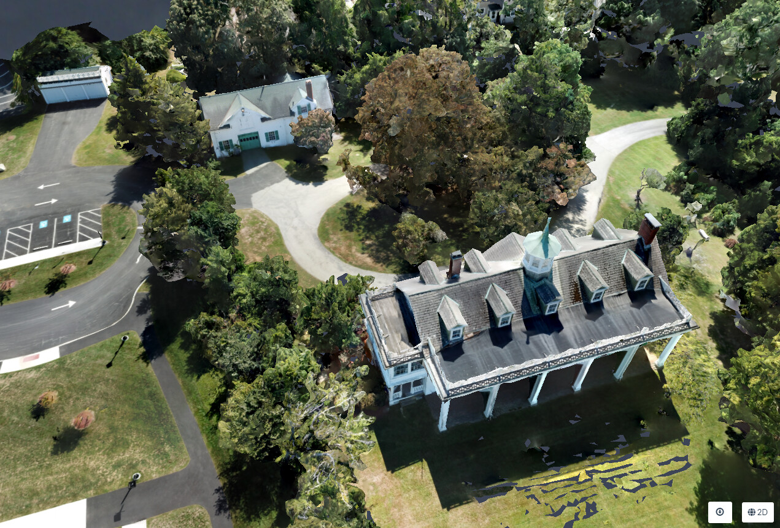
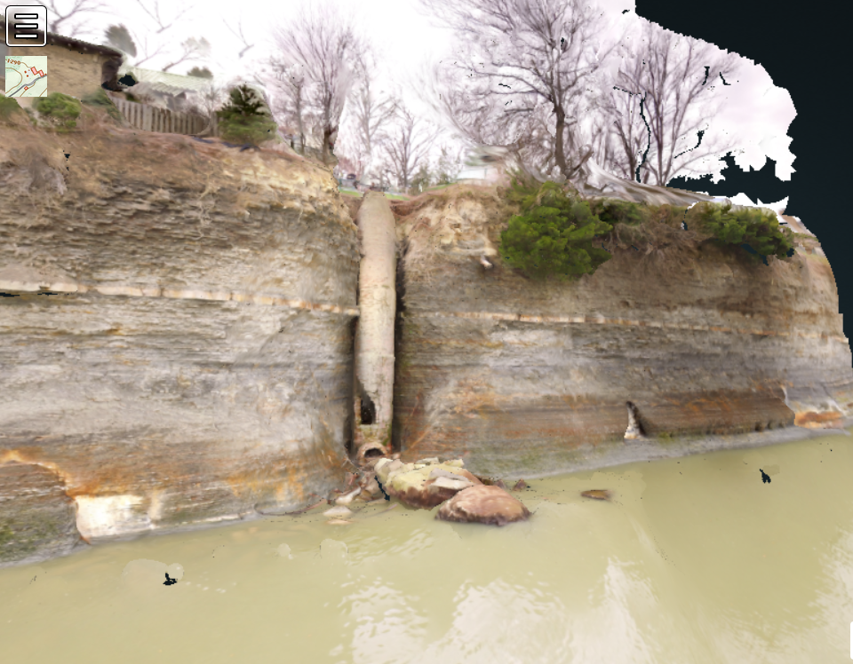
Outputs
Textured 3D Model (.obj)
→ Sketchfab, et al for sharing
→ CAD, Blender
→ 3D print
Photo Credit: Jamie Portolese, Corey Snipes

Slide 14
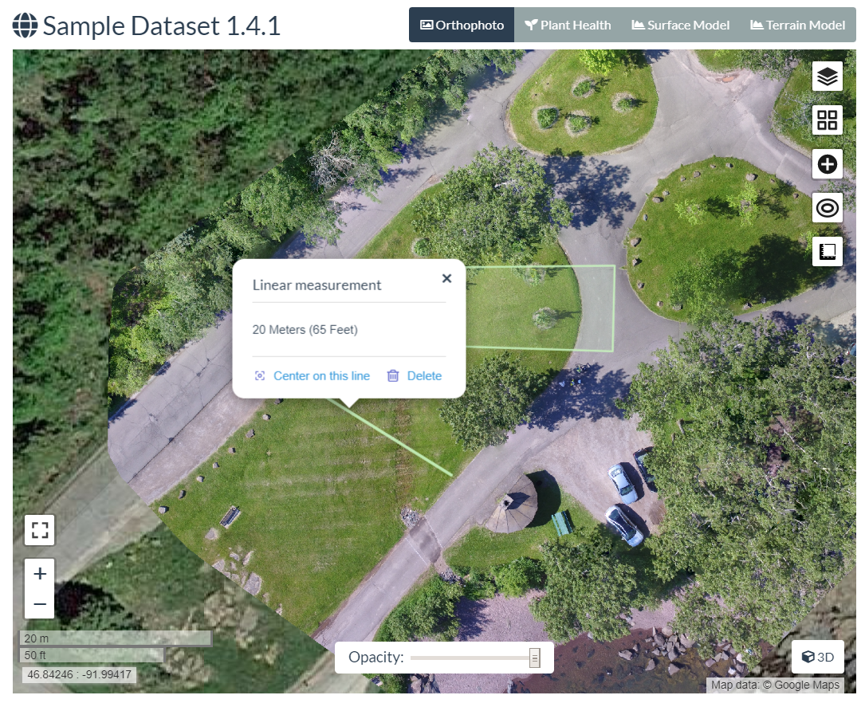
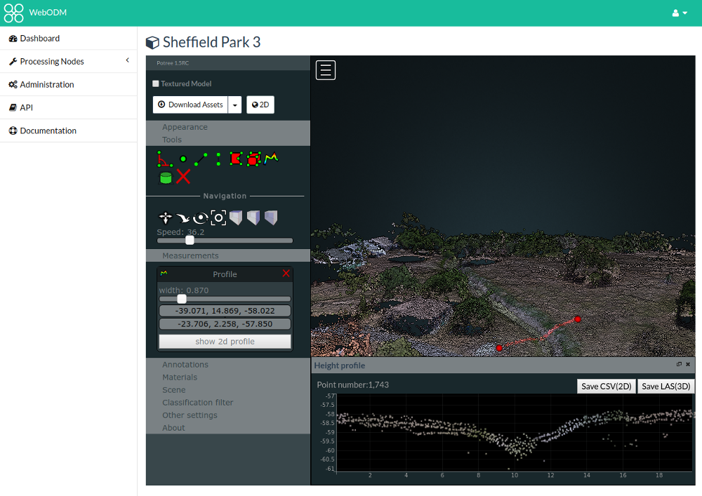
Within ODM
Measurement
Analysis

Slide 15
What’s New in ODM
2019 to 2021

Slide 16
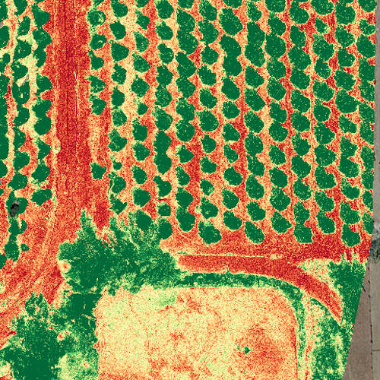

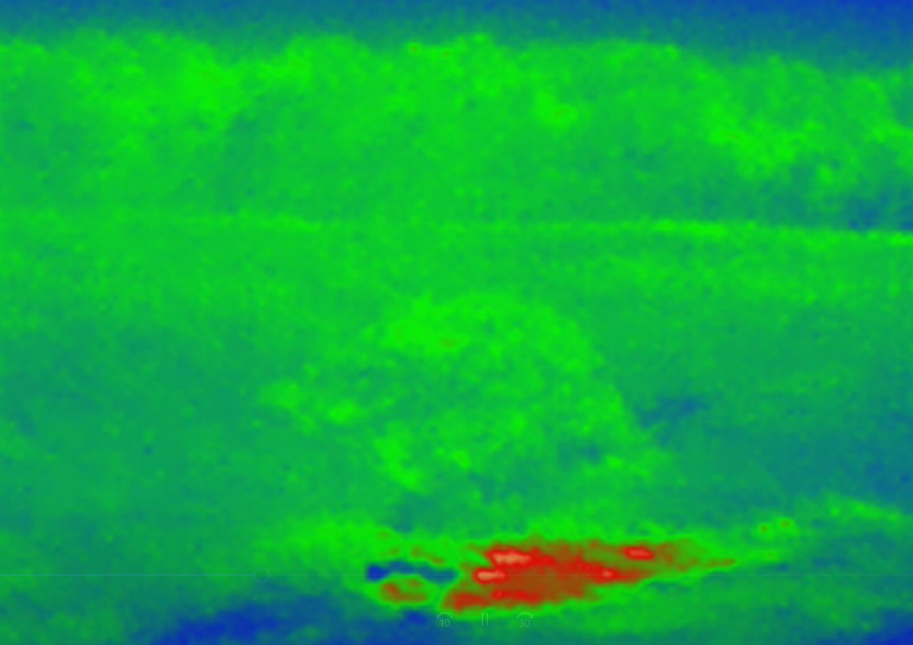
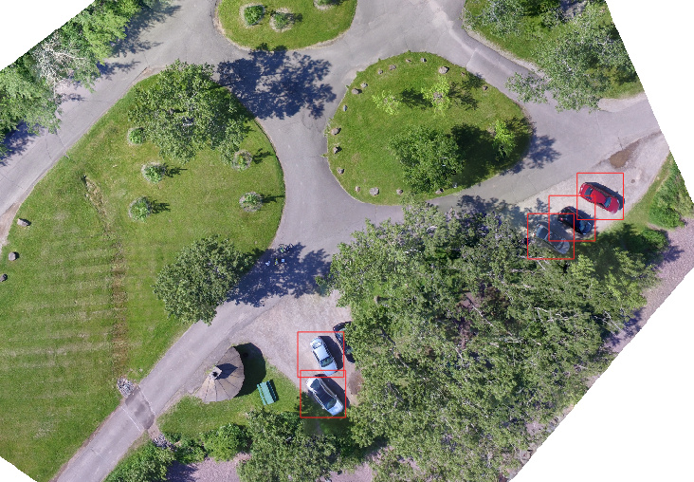

Processing Capabilities
Improved Support for Multi-Spectral Imagery
Support for Thermal Imagery
Support for Processing via MicMac
Documented Paths to Object Counting/Detection
Terrain Contours in DSM/DTM
KMZ export
Photo Credit: opendronemap.org, Corey Snipes, micmac.ensg.eu, google.com

Slide 17
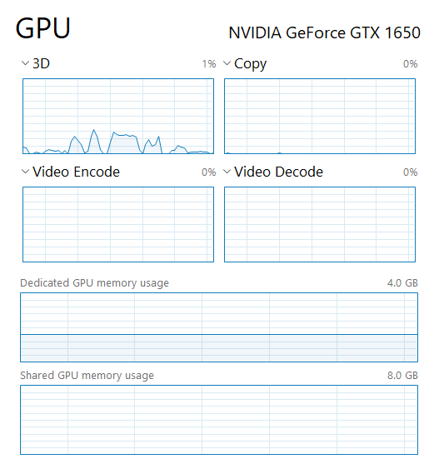
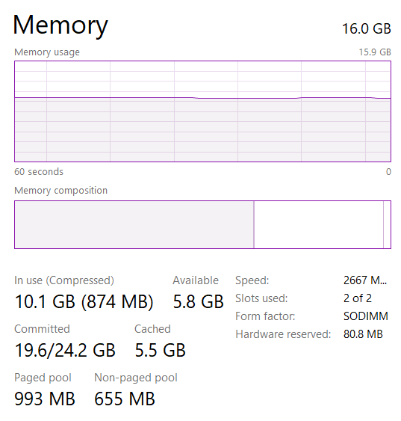
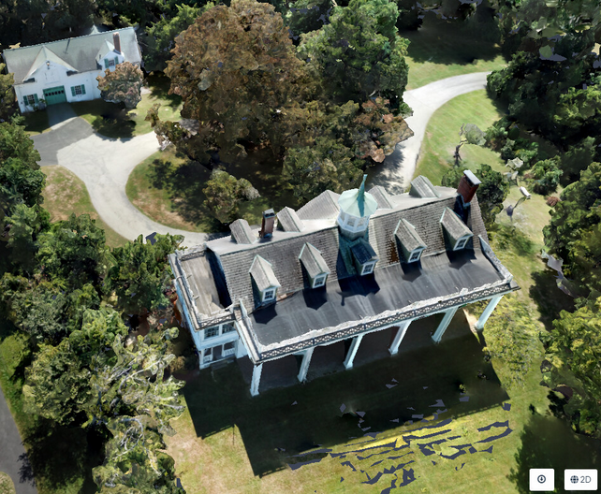
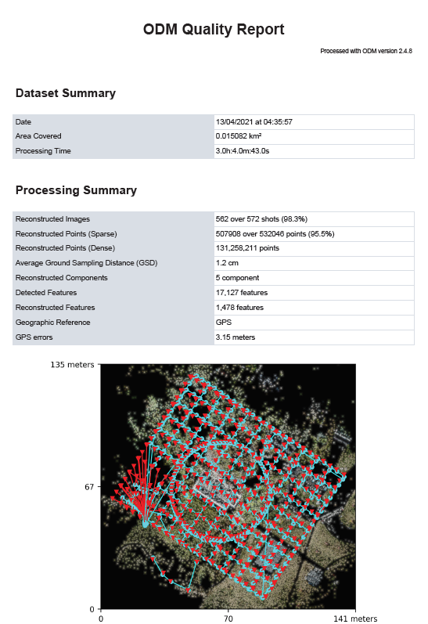
Speed and Quality
Faster Processing
GPU Support (Preliminary)
More Efficient Memory Usage
Improved 2D, 3D Output Quality
Quality Report
Photo Credit: Jamie Portolese

Slide 18
Scalability
Split/Merge
ClusterODM
Photo Credit: opendronemap.org

Slide 19





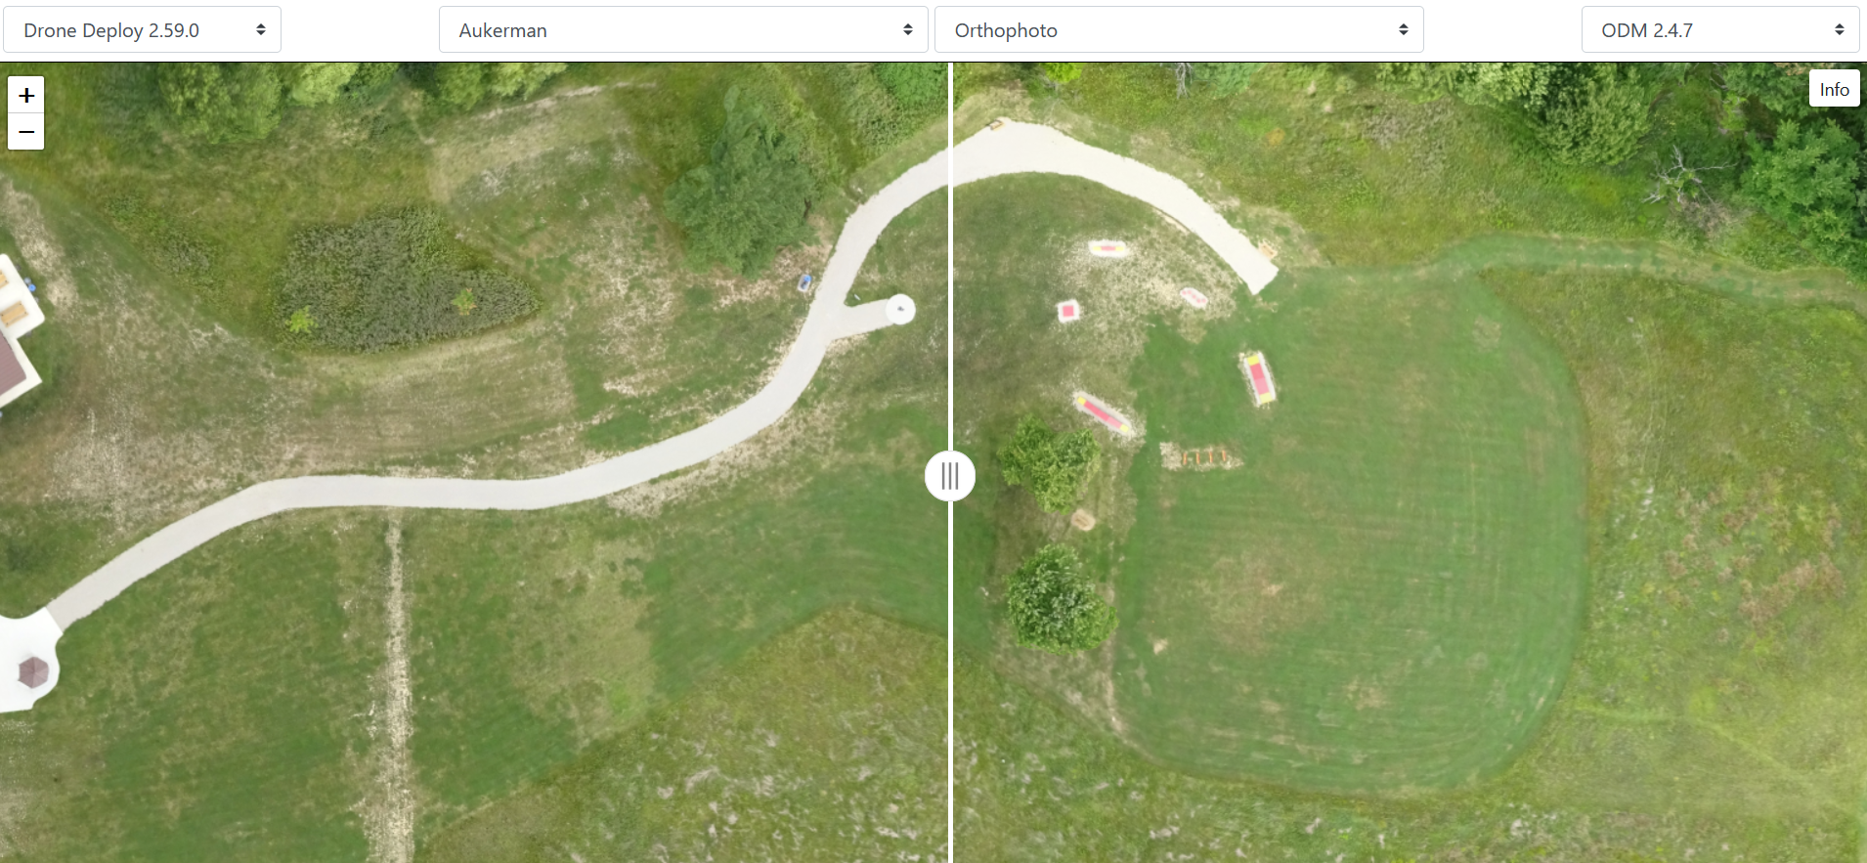

Usability
Simplified Installation
Docker
SNAP Packaging
WSL2 Support
Paid Installers (Includes Installation Support)
Localized/International Language Support
Support for WebXR
Performance Benchmarking
UAV Arena – Side by Side Comparison of Outputs from ODM, Pix4D, MicMac, DroneDeploy, Metashape, DroneMapper
Photo Credit: docker.com, snapcraft.io, docs.microsoft.com, immersive-web.github.io

Slide 20

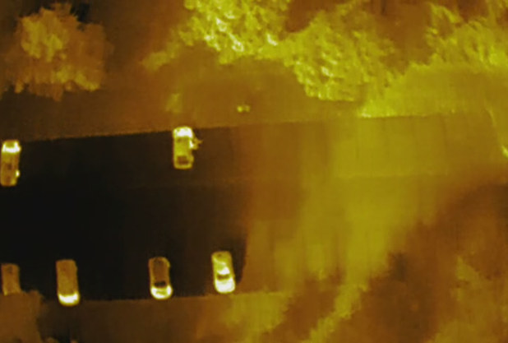


In Process / Upcoming Capabilities
Expanded language support
Expanded thermal camera support
Expanded GPU utilization during processing
Native installation for Windows (possibly also Linux, Mac)
Support for supplemental images from ground, 360’ cameras
Photo Credit: Corey Snipes, blog.microsoft.com

Slide 21
In Summary

Slide 22

In Summary, OpenDroneMap Is…
Robust Toolkit for UAS Photogrammetry
Open-Source, No Licensing Fees
Global Community of Users and Contributors
Growing and Improving Every Year
Can ODM Help You?

Slide 23
Thank You
Contact Me
https://www.linkedin.com/in/coreysnipes/
@coreysnipes on Twitter
corey@twomile.com
Learn More About ODM
https://community.opendronemap.org
https://docs.opendronemap.org
https://odmbook.com - $30
https://opendronemap.github.io/UAVArena/
https://opendronemap.org

Slide 24
Backup

Slide 25
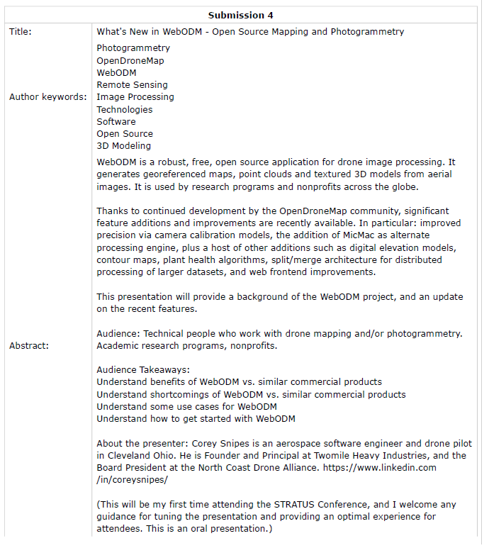
Submitted
Submission 4: What's New in WebODM - Open Source Mapping and Photogrammetry

Slide 26
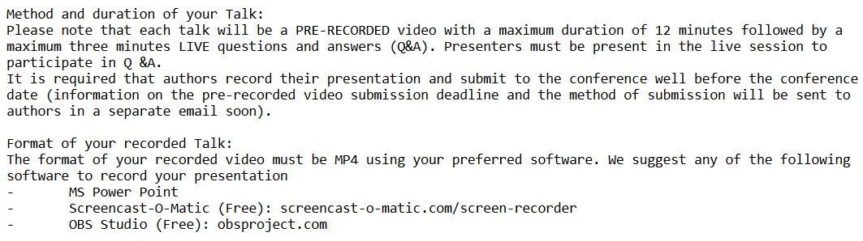
Instructions

Slide 27
Photos
https://community.opendronemap.org/t/best-results-yet/7335/4
https://docs.opendronemap.org/tutorials.html

